Slide 1
API

Slide 2
[ApiController]
[Route("api/[controller]")]
public class HomeController : Controller
{
[HttpGet("{nome}")]
public ActionResult Saudacao(string nome)
{
return Ok($"Olá {nome}");
}
[HttpGet("saudacao")]
public ActionResult SaudacaoQuery([FromQuery] string nome)
{
return Ok($"Olá {nome}");
}
[HttpGet("saudacao-header")]
public ActionResult SaudacaoHeader([FromHeader] string nome)
{
return Ok($"Olá {nome}, recebido via header!");
}
[HttpPost("saudacao-body")]
public ActionResult SaudacaoBody([FromBody] string nome)
{
return Ok($"Olá {nome}, recebido via body!");
}
}
}

Slide 3
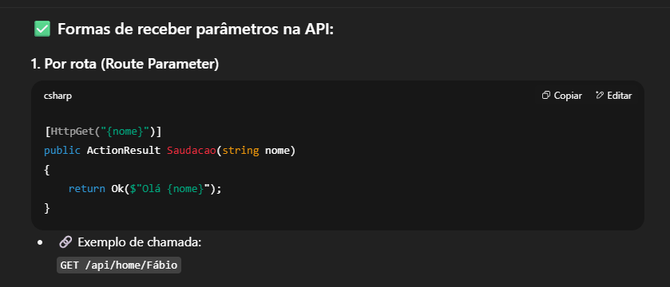

Slide 4
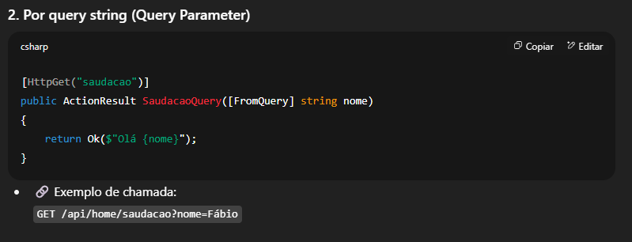

Slide 5
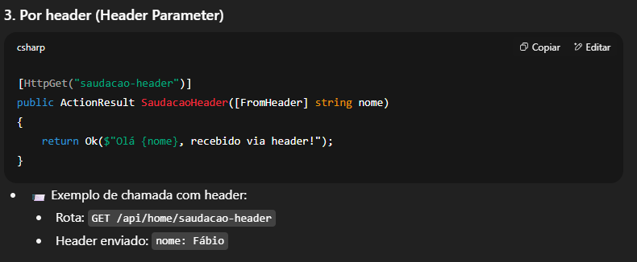

Slide 6
